Slide 1
Number Representation
Mainak Chaudhuri
Indian Institute of Technology Kanpur

Slide 2
Sketch
Unsigned and signed integers
Overflow in integer operations
Floating-point numbers
Overflow in floating-point operations
Underflow in floating-point operations
Rounding modes

Slide 3
Unsigned and signed integers
Numbers in a computer (or a processor) are represented in binary
Digital designs are realized using devices such as transistors which can be made to operate at two discrete voltage levels representing 0 and 1 conveniently
Number of bits devoted to represent a number is fixed by the design and cannot be extended after the design is finished
Puts an upper bound on the value of the largest representable number in a computer
If a computation generates a number that cannot fit within these bits, an overflow is said to have occurred

Slide 4
Unsigned and signed integers
Non-negative integers (often called unsigned integers) can be represented using standard binary
Negative integers require the sign to be encoded appropriately
Four possibilities have been tried: sign magnitude, two’s complement, one’s complement, biased
Sign magnitude is the simplest: reserve the most significant bit to represent the sign of the integer
Ambiguous representation of zero (00…0 and 100…0)
Addition requires extra logic to set the result’s sign

Slide 5
Representing negative integers
Sign magnitude representation
With n bits to represent a number, the representable range is -2^{n-1}+1 to 2^{n-1}-1
Two’s complement representation
Non-negative integers are represented as in sign magnitude representation
MSB is 0 followed by the magnitude in n-1 bits
An integer x and its negative add up to 2^{n}
x+(-x) = (2^{n} – 1) + 1 or (-x) = (2^{n} – 1) – x + 1
Observe: (2^{n} – 1) – x is same as bitwise inversion of x
Offers an easy implementation to derive –x from x
Invert bits of x to get y; add 1 to y; ignore carry out of MSB

Slide 6
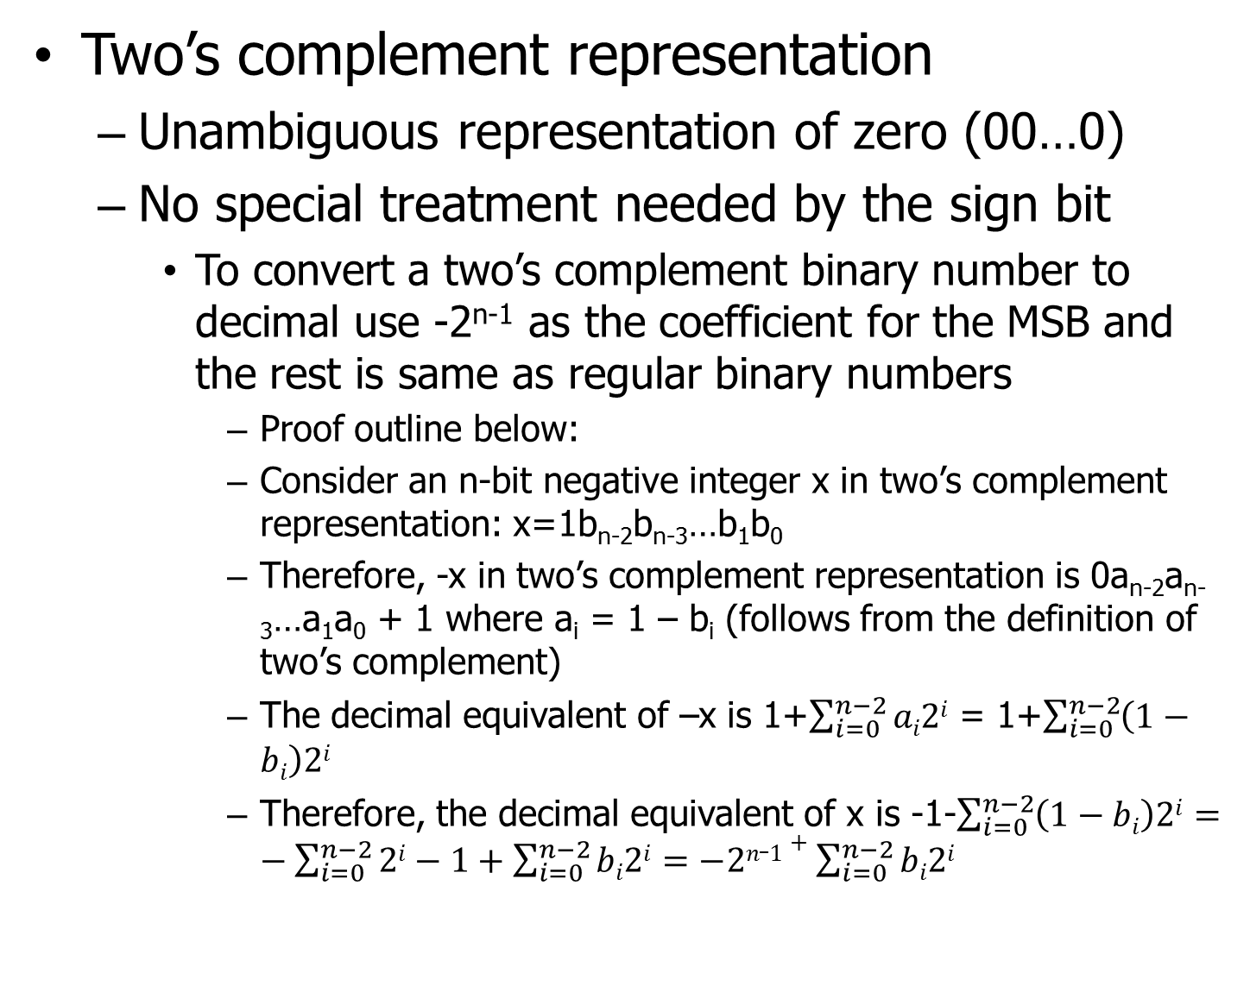
Representing negative integers
Two’s complement representation
Unambiguous representation of zero (00…0)
No special treatment needed by the sign bit
To convert a two’s complement binary number to decimal use -2^{n-1} as the coefficient for the MSB and the rest is same as regular binary numbers
Proof outline below:
Consider an n-bit negative integer x in two’s complement representation: x=1b_{n-2}b_{n-3}…b₁b₀
Therefore, -x in two’s complement representation is 0a_{n-2}a_{n-3}…a₁a₀ + 1 where a_{i} = 1 – b_{i} (follows from the definition of two’s complement)
The decimal equivalent of –x is 1+$\sum_{i=0}^{n−2}{ai2i}$ = 1+$\sum_{i=0}^{n−2}{\left(1−bi\right)2i}$
Therefore, the decimal equivalent of x is -1-$\sum_{i=0}^{n−2}{\left(1−bi\right)2i}=−\sum_{i=0}^{n−2}{2i−1+\sum_{i=0}^{n−2}{bi2i}=−2n_1+\sum_{i=0}^{n−2}{bi2i}}$

Slide 7
Representing negative integers
Two’s complement representation
No special hardware or step required in binary addition and subtraction (A+B or A-B)
A and B are in two’s complement representation
An extra array of xor gates to implement A-B
Ignore carry out of MSB position
Basic binary addition algorithm remains unchanged
Only drawback is an imbalanced range on positive and negative sides
Representable range: -2^{n-1} to 2^{n-1}-1
Two’s complement representation is used in all computers today for handling integers

Slide 8
Representing negative integers
Two’s complement adder/subtractor
For A+B, the add/sub input wire is set to 0 and for A-B, the add/sub input wire is set to 1
Both A and B must be in two’s complement representation (assumes n=4)
C_{out} is usually ignored
Actually used to detect overflows (will discuss later)
add/sub
b₃
b₂
b₁
b₀
a₃
a₂
a₁
a₀
XOR
XOR
XOR
XOR
FA3
FA2
FA1
FA0
C_{out}
C_{in}
S₃
S₂
S₁
S₀

Slide 9
Representing negative integers
One’s complement representation
An integer x and its negative add up to 2^{n} – 1
x+(-x) = 2^{n} – 1 or (-x) = 2^{n} – 1 – x
Just bitwise inversion of x is –x
Ambiguous representation of zero
00…0 and 11…1
How easy is addition or subtraction?
Various cases have different treatments
Not as easy as two’s complement addition/subtraction
Balanced ranges on positive and negative sides
-2^{n-1}+1 to 2^{n-1} – 1

Slide 10
Representing negative integers
Biased representation
Representation of an integer x is x+bias
x+bias is represented as a regular binary number with no sign bit
bias is a constant fixed by the representation
The goal is to avoid negative numbers all together i.e., x+bias ≥ 0
Smallest representable number is -bias
A typical bias is 2^{n-1} for n-bit representation
An integer x is represented as x+2^{n-1} using unsigned binary representation
Imbalanced range on positive and negative sides
-bias to 2^{n} – 1 – bias
-2^{n-1} to 2^{n-1} – 1 when bias is 2^{n-1}

Slide 11
Representing negative integers
Use of two’s complement representation
All computers use this representation
The following C code can be used to verify whether a computer is using two’s complement representation for 32-bit integers (“int” type)
int x = -10; // Any value can be used
unsigned bits = *((unsigned*)&x);
printf (“bits = %#x\n”, bits);
Similarly, 64-bit integers (“long long” type) can be verified
long long x = -10;
unsigned long long bits = *((unsigned long long*)&x); printf (“bits = %#llx\n”, bits);

Slide 12
Overflow in integer operations
Overflow occurs if the result of a computation cannot fit within the given number of bits
In usual binary representation, if there is a carry-out in the MSB position of an addition, overflow is said to occur
In two’s complement representation, overflow occurs if and only if the carry in to the MSB is different from carry out from the MSB
Proof?
Let the carry in to the MSB be c_{n-1} and carry out from the MSB be c_{n} when adding two n-bit numbers

Slide 13
Overflow in integer operations
Overflow in two’s complement addition
Suppose that we are adding A (a_{n-1}a_{n-2}…a₀) and B (b_{n-1}b_{n-2}…b₀) both in two’s complement representation and let the sum be S (s_{n-1}s_{n-2}…s₀)
Case I: c_{n-1}=0, c_{n}=1
Therefore, a_{n-1}=b_{n-1}=1 and s_{n-1}=0
This is an overflow condition because adding two negative numbers cannot yield a positive number
Case II: c_{n-1}=1, c_{n}=0
Therefore, a_{n-1}=b_{n-1}=0 and s_{n-1}=1
This is an overflow condition because adding two positive numbers cannot yield a negative number

Slide 14
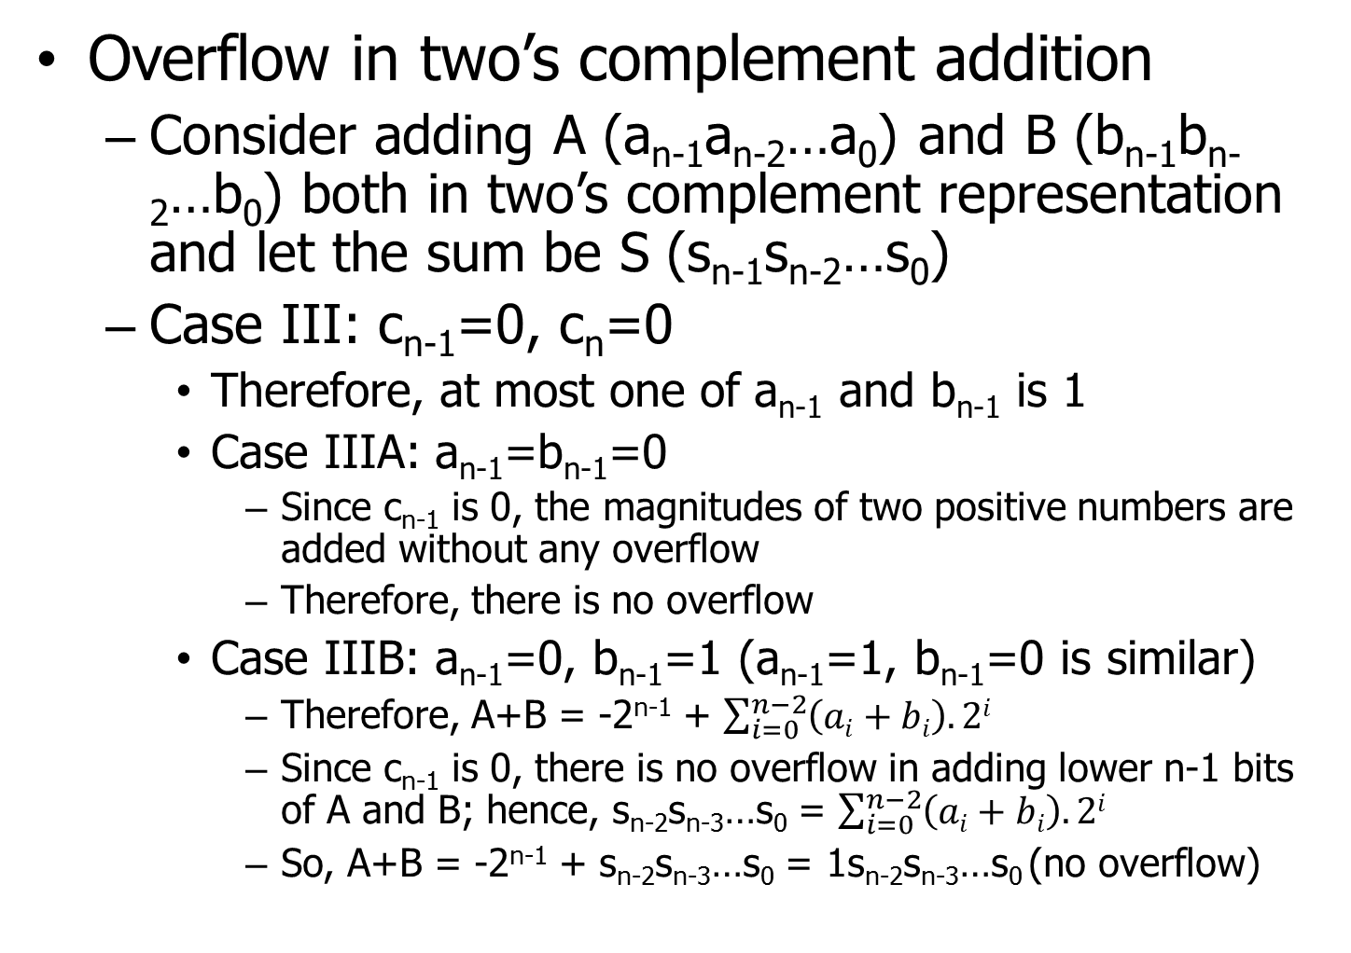
Overflow in integer operations
Overflow in two’s complement addition
Consider adding A (a_{n-1}a_{n-2}…a₀) and B (b_{n-1}b_{n-2}…b₀) both in two’s complement representation and let the sum be S (s_{n-1}s_{n-2}…s₀)
Case III: c_{n-1}=0, c_{n}=0
Therefore, at most one of a_{n-1} and b_{n-1} is 1
Case IIIA: a_{n-1}=b_{n-1}=0
Since c_{n-1} is 0, the magnitudes of two positive numbers are added without any overflow
Therefore, there is no overflow
Case IIIB: a_{n-1}=0, b_{n-1}=1 (a_{n-1}=1, b_{n-1}=0 is similar)
Therefore, A+B = -2^{n-1} + $\sum_{i=0}^{n−2}{\left(ai+bi\right).2i}$
Since c_{n-1} is 0, there is no overflow in adding lower n-1 bits of A and B; hence, s_{n-2}s_{n-3}…s₀ = $\sum_{i=0}^{n−2}{\left(ai+bi\right).2i}$
So, A+B = -2^{n-1} + s_{n-2}s_{n-3}…s₀ = 1s_{n-2}s_{n-3}…s₀ (no overflow)

Slide 15
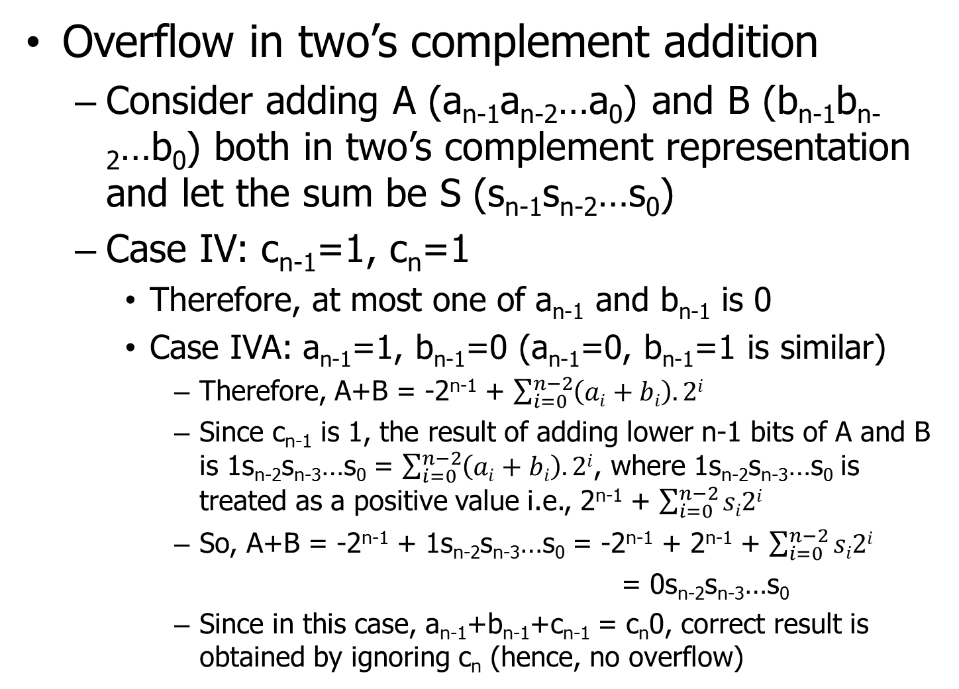
Overflow in integer operations
Overflow in two’s complement addition
Consider adding A (a_{n-1}a_{n-2}…a₀) and B (b_{n-1}b_{n-2}…b₀) both in two’s complement representation and let the sum be S (s_{n-1}s_{n-2}…s₀)
Case IV: c_{n-1}=1, c_{n}=1
Therefore, at most one of a_{n-1} and b_{n-1} is 0
Case IVA: a_{n-1}=1, b_{n-1}=0 (a_{n-1}=0, b_{n-1}=1 is similar)
Therefore, A+B = -2^{n-1} + $\sum_{i=0}^{n−2}{\left(ai+bi\right).2i}$
Since c_{n-1} is 1, the result of adding lower n-1 bits of A and B is 1s_{n-2}s_{n-3}…s₀ = $\sum_{i=0}^{n−2}{\left(ai+bi\right).2i}$, where 1s_{n-2}s_{n-3}…s₀ is treated as a positive value i.e., 2^{n-1} + $\sum_{i=0}^{n−2}{si2i}$
So, A+B = -2^{n-1} + 1s_{n-2}s_{n-3}…s₀ = -2^{n-1} + 2^{n-1} + $\sum_{i=0}^{n−2}{si2i}$
= 0s_{n-2}s_{n-3}…s₀
Since in this case, a_{n-1}+b_{n-1}+c_{n-1} = c_{n}0, correct result is obtained by ignoring c_{n} (hence, no overflow)

Slide 16
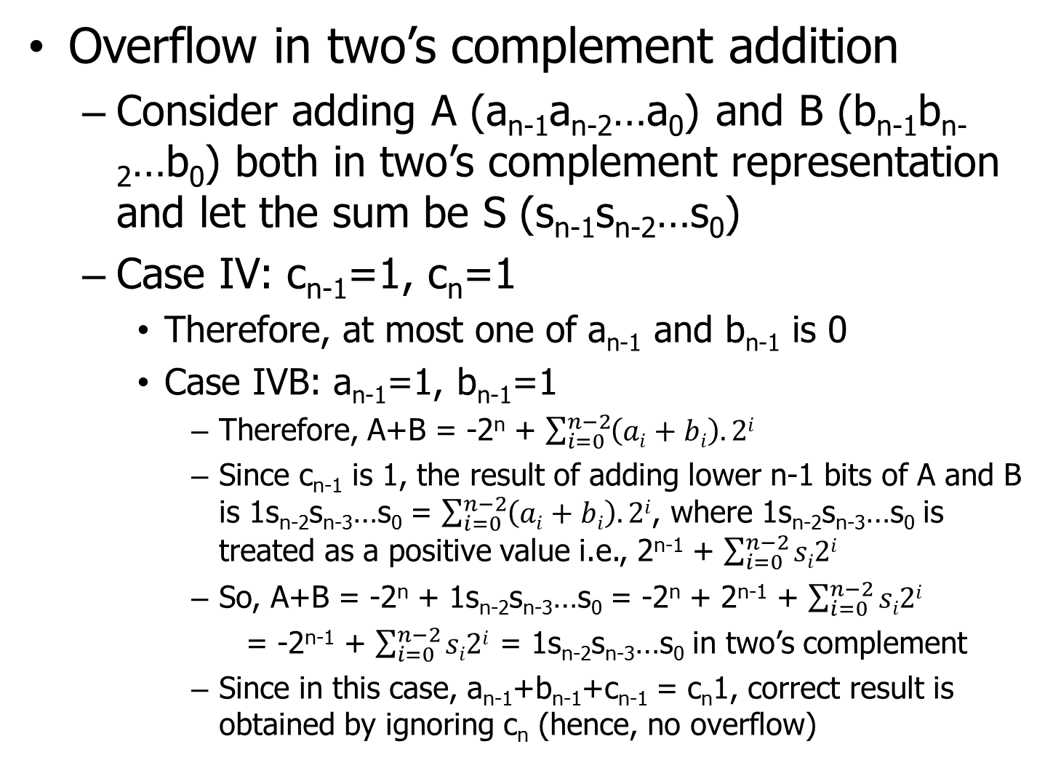
Overflow in integer operations
Overflow in two’s complement addition
Consider adding A (a_{n-1}a_{n-2}…a₀) and B (b_{n-1}b_{n-2}…b₀) both in two’s complement representation and let the sum be S (s_{n-1}s_{n-2}…s₀)
Case IV: c_{n-1}=1, c_{n}=1
Therefore, at most one of a_{n-1} and b_{n-1} is 0
Case IVB: a_{n-1}=1, b_{n-1}=1
Therefore, A+B = -2^{n} + $\sum_{i=0}^{n−2}{\left(ai+bi\right).2i}$
Since c_{n-1} is 1, the result of adding lower n-1 bits of A and B is 1s_{n-2}s_{n-3}…s₀ = $\sum_{i=0}^{n−2}{\left(ai+bi\right).2i}$, where 1s_{n-2}s_{n-3}…s₀ is treated as a positive value i.e., 2^{n-1} + $\sum_{i=0}^{n−2}{si2i}$
So, A+B = -2^{n} + 1s_{n-2}s_{n-3}…s₀ = -2^{n} + 2^{n-1} + $\sum_{i=0}^{n−2}{si2i}$
= -2^{n-1} + $\sum_{i=0}^{n−2}{si2i}$ = 1s_{n-2}s_{n-3}…s₀ in two’s complement
Since in this case, a_{n-1}+b_{n-1}+c_{n-1} = c_{n}1, correct result is obtained by ignoring c_{n} (hence, no overflow)

Slide 17
Floating-point numbers
Real numbers are represented using scientific notation
a.b x 10^{c}
Said to be normalized if there is only one non-zero digit to the left of the decimal point
1≤a≤9
Always possible to normalize a real number
Digital computers represent real numbers as floating-point binary numbers using normalized scientific notation
1.b x 2^{c} where b and c are binary numbers
Binary point as opposed to decimal point

Slide 18
Floating-point numbers
Normalized scientific representation
Floating-point because the binary point can be moved by adjusting the exponent
How to convert a decimal real number to normalized scientific binary notation?
Procedure for integer part: continued division
Procedure for fraction part: continued multiplication
A representation of normalized floating-point number fixes the number of bits needed for b and c, given a fixed total number of bits
Trade-off between range and precision
If b has more bits then c has less

Slide 19
Floating-point numbers
Normalized scientific representation has three advantages
Simplifies exchange of floating-point data between computers due to a standard representation
Simplifies floating-point arithmetic algorithms because all operands are in the same format
Compacts the representation by discarding leading zeros on the left hand side
0.0000000010101 is same as 1.0101 x 2⁻⁹ and it is enough to store b=0101 and c=-9
b is referred to as the fraction (or mantissa) and c is referred to as the exponent

Slide 20
Floating-point numbers
Normalized scientific representation
IEEE 754 standard dictates the number of bits reserved for mantissa and exponent
It is a standard format for representing floating-point numbers
All computers are expected to follow this format
A single-precision floating-point number is represented using 32 bits
Sign magnitude representation
MSB is sign bit
Least significant 23 bits represent the mantissa
24 bits of (1 + mantissa) represent the significand
Middle eight bits represent the exponent

Slide 21
Floating-point numbers
IEEE 754 single-precision format
Exponent field needs to encode both positive and negative exponents
Necessary to choose an encoding such that the entire 31-bit magnitude field is monotonic in the value of the floating-point number
A larger magnitude floating-point number should have a larger 31-bit magnitude field compared to a smaller magnitude floating-point number
Helps to sort numbers quickly by magnitude
Mantissa is already monotonic in the value of the fraction
Cannot use two’s complement encoding for exponent
Negative exponents will be represented by large numbers

Slide 22
Floating-point numbers
IEEE 754 single-precision format
Biased encoding of exponent with bias set to 127
Encoded exponent = 127 + actual exponent
Actual exponent is allowed to range from -126 to 127 i.e., the encoded exponent can range from 00000001 to 11111110
Encoded exponent cannot be 00000000 or 11111111 because these encodings are reserved to represent some special numbers
Notice that larger encoded exponent now represents larger actual exponent because biased encoding preserves monotonicity
Two’s complement encoding does not preserve monotonicity

Slide 23
Floating-point numbers
IEEE 754 single-precision format
Largest non-negative number
+1.111…1 x 2¹²⁷ = (2 – 2⁻²³) x 2¹²⁷
Smallest positive number
+1.000…0 x 2⁻¹²⁶
Negative number with smallest magnitude
-1.000…0 x 2⁻¹²⁶
Negative number with largest magnitude
-1.111…1 x 2¹²⁷ = -(2 – 2⁻²³) x 2¹²⁷
0
11111110
11111111111111111111111
0
00000001
00000000000000000000000
1
00000001
00000000000000000000000
1
11111110
11111111111111111111111

Slide 24
Floating-point numbers
IEEE 754 single-precision format
Special numbers
Encoding of zero (two possible representations):
Encoding of +infinity:
Encoding of –infinity:
Encoding of NaN (result of 0/0, sqrt(-n), 0*inf, etc.):
X
00000000
00000000000000000000000
0
11111111
00000000000000000000000
1
11111111
00000000000000000000000
X
11111111
Anything non-zero

Slide 25
Floating-point numbers
IEEE 754 single-precision format
What about the numbers between 0 and ±N where N is the smallest representable magnitude (1.000…0 x 2⁻¹²⁶)?
These are called denormalized numbers because they are of the form ±0.b x 2^{c} where c=-126
Largest non-negative denormalized number:
+0.111…1 x 2⁻¹²⁶ = (1 – 2⁻²³) x 2⁻¹²⁶
Smallest positive denormalized number:
+0.000…01 x 2⁻¹²⁶ = 2⁻¹⁴⁹
Negative denormalized range is similar
0
00000000
11111111111111111111111
0
00000000
00000000000000000000001

Slide 26
Floating-point numbers
IEEE 754 single-precision format
Representable magnitudes:
0
Denormalized: 2⁻¹⁴⁹ to (1 – 2⁻²³) x 2⁻¹²⁶
Normalized: 2⁻¹²⁶ to (2 – 2⁻²³) x 2¹²⁷
Infinity
Anything with an exponent bigger than 127
Note: a mantissa that is larger than the largest representable mantissa (i.e., 1111…1) does not make the magnitude infinity (will discuss this soon)
NaN
Use of IEEE 754 single-precision format
The C data type “float” translates to 32-bit single-precision format

Slide 27
Floating-point numbers
Use of IEEE 754 single-precision format
You can verify that the computer uses IEEE 754 single-precision format for float through the following code
float x = -3.75; // Can use any float value
// -3.75 = -11.11 = -1.111 x 2¹ in binary
// biased exponent = 128, mantissa = 111000…0
unsigned int sbit = ((*((unsigned int*)&x)) >> 31) & 1;
unsigned int exponent = ((*((unsigned int*)&x)) >> 23)
& 0xff;
unsigned int fraction = (*((unsigned int*)&x)) & 0x7fffff;
printf(“Sign bit: %u, biased exponent: %u, actual exponent: %d, mantissa: %#x\n”, sbit, exponent, exponent – 127, fraction);

Slide 28
Floating-point numbers
IEEE 754 double-precision format
Improves both precision and range over the single-precision format
64-bit representation
MSB is sign bit
Least significant 52 bits represent mantissa
The middle 11 bits represent biased exponent with a bias of 1023
Actual exponent can range from -1022 to 1023
Largest representable normalized magnitude
1.111…1 x 2¹⁰²³ = (2 – 2⁻⁵²) x 2¹⁰²³
Smallest representable normalized magnitude
1.000…0 x 2⁻¹⁰²² = 2⁻¹⁰²²

Slide 29
Floating-point numbers
IEEE 754 double-precision format
Largest representable denormalized magnitude
0.111…1 x 2⁻¹⁰²² = (1 – 2⁻⁵²) x 2⁻¹⁰²²
Smallest representable denormalized magnitude
0.000…01 x 2⁻¹⁰²² = 2⁻¹⁰⁷⁴
Zero
Exponent = 0, Mantissa = 0
Infinity
Exponent = 11111111111, Mantissa = 0
NaN
Exponent = 11111111111, Mantissa = non-zero
Use of IEEE 754 double-precision format
The C data type “double” translates to 64-bit double-precision format

Slide 30
Floating-point numbers
Use of IEEE 754 double-precision format
You can verify that the computer uses IEEE 754 double-precision format for double through the following code
double x = -3.75; // Can use any float value
unsigned int sbit = ((*((unsigned long long*)&x)) >> 63) & 1;
unsigned int exponent = ((*((unsigned long long*)&x)) >> 52) & 0x7ff;
unsigned long long fraction = (*((unsigned long long*)&x)) & 0xfffffffffffff;
printf(“Sign bit: %u, biased exponent: %u, actual exponent: %d, mantissa: %#llx\n”, sbit, exponent, exponent – 1023, fraction);

Slide 31
Floating-point numbers
IEEE 754 half-precision format
Lower range and precision compared to single-precision for computers having narrow busses/operands
16-bit representation
MSB is sign bit
Least significant ten bits represent mantissa
The middle five bits represent the biased exponent with a bias of 15
Actual exponent can range from -14 to 15
Largest representable normalized magnitude
1.1111111111 x 2¹⁵ = (2 – 1/1024) x 2¹⁵
Smallest representable normalized magnitude
1.0000000000 x 2⁻¹⁴ = 2⁻¹⁴

Slide 32
Floating-point numbers
IEEE 754 half-precision format
Largest representable denormalized magnitude
0.1111111111 x 2⁻¹⁴ = (1 – 1/1024) x 2⁻¹⁴
Smallest representable denormalized magnitude
0.000…01 x 2⁻¹⁴ = 2⁻²⁴
Zero
Exponent = 0, Mantissa = 0
Infinity
Exponent = 11111, Mantissa = 0
NaN
Exponent = 11111, Mantissa = non-zero

Slide 33
Floating-point numbers
IEEE 754 quadruple-precision format
Much higher range and precision compared to double-precision
No computer supports it yet
128-bit representation
MSB is sign bit
Least significant 112 bits represent mantissa
The middle 15 bits represent the biased exponent with a bias of 16383
Actual exponent can range from -16382 to 16383
Largest representable normalized magnitude
1.111…1 x 2¹⁶³⁸³ = (2 – 2⁻¹¹²) x 2¹⁶³⁸³
Smallest representable normalized magnitude
1.000…0 x 2⁻¹⁶³⁸² = 2⁻¹⁶³⁸²

Slide 34
Floating-point numbers
IEEE 754 quadruple-precision format
Largest representable denormalized magnitude
0.111…1 x 2⁻¹⁶³⁸² = (1 – 2⁻¹¹²) x 2⁻¹⁶³⁸²
Smallest representable denormalized magnitude
0.000…01 x 2⁻¹⁶³⁸² = 2⁻¹⁶⁴⁹⁴
Zero
Exponent = 0, Mantissa = 0
Infinity
Exponent = 111…1, Mantissa = 0
NaN
Exponent = 111…1, Mantissa = non-zero

Slide 35
Overflow in floating-point ops
What happens if the magnitude of a floating-point number exceeds the largest representable by the corresponding format?
E.g., float x > (2 – 2⁻²³) x 2¹²⁷
May cause an overflow if exponent is larger than maximum allowed (e.g., 127 in single-precision)
The number is treated as +infinity or –infinity depending on the sign of the number
What if the fraction cannot fit within the mantissa field, but the exponent is within range?
Not an overflow
Handled by rounding the mantissa (default is round to nearest and round to nearest even for halfway round)
Loss of precision

Slide 36
Underflow in floating-point ops
What happens if the magnitude of a floating-point number is less than the smallest representable by the corresponding format?
E.g., float x < 2⁻¹⁴⁹
May cause an underflow if an exponent smaller than the minimum (e.g., -126 in single-precision) is required to represent the number
E.g., 2⁻¹⁵⁰ in single-precision or 2⁻¹⁰⁷⁵ in double-precision
The number is treated as zero in this case
Denormalized numbers are said to undergo gradual underflow as more and more leading zeros appear on the right side of the binary point ultimately becoming zero below 2⁻¹⁴⁹

Slide 37
Rounding modes
IEEE 754 rounding modes
Round to nearest (default behavior)
Round to nearest even for halfway rounding
After rounding, the least significant representable mantissa bit should be even (see following single-precision examples)
Example: 1.1111…1 (has 24 1s in mantissa) is rounded to 2.0 (in decimal) i.e., 1.0 x 2¹ in binary
Example: 1.111…101 (has 22 1s followed by a 0 and a 1 in mantissa) is rounded to 1.111…10 (has 22 1s followed by a 0 in mantissa)
Round toward zero
Round toward +infinity
Round toward –infinity
A computer can choose one of the modes

